Slide 1
MySQL and Assignment

Slide 2

Camera Expectations

Slide 3



Before we start… Please have your camera switched on.
Camera Expectations
This is a mandatory requirement for the duration of the course.
You are studying a regulated qualification, your tutor needs to see that it is the right person participating throughout the course.
Our job is to prepare you for work in an age where in almost any job there is likely to be at least some aspect of remote engagement with your employer.
Online learning is to be treated the same way as a classroom learning, you must be physically visible to interact with your tutor and other learners in order to create an engaging group dynamic.

Slide 4
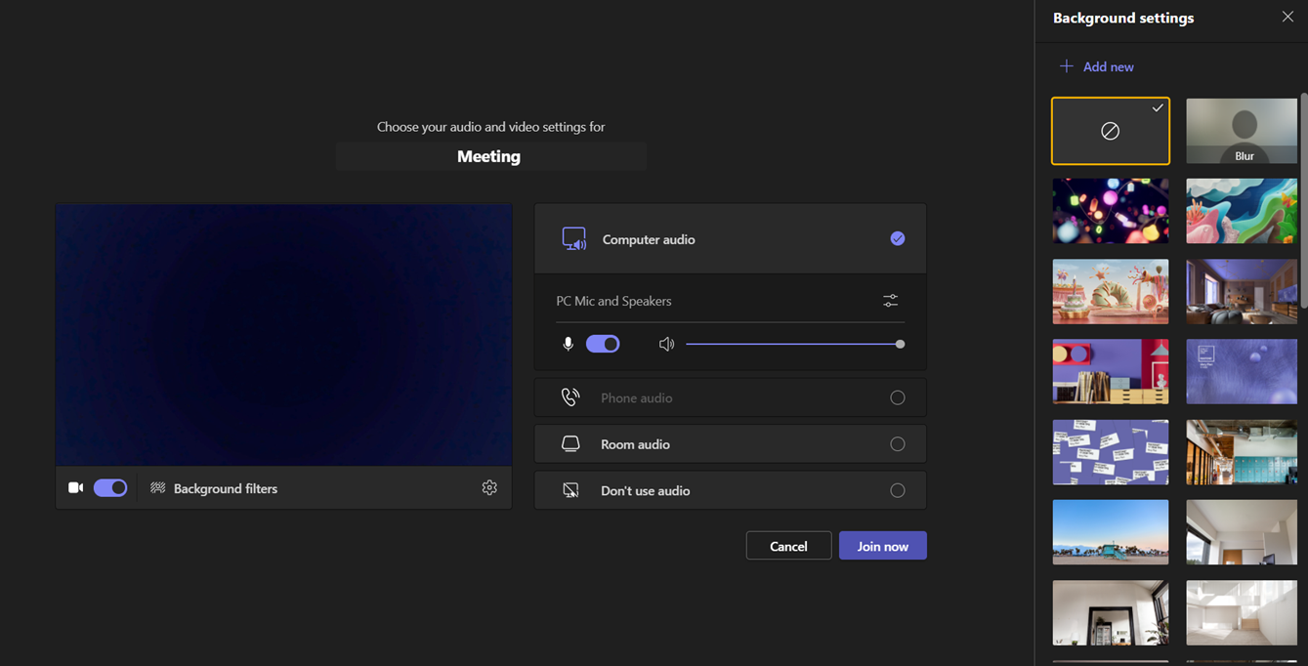
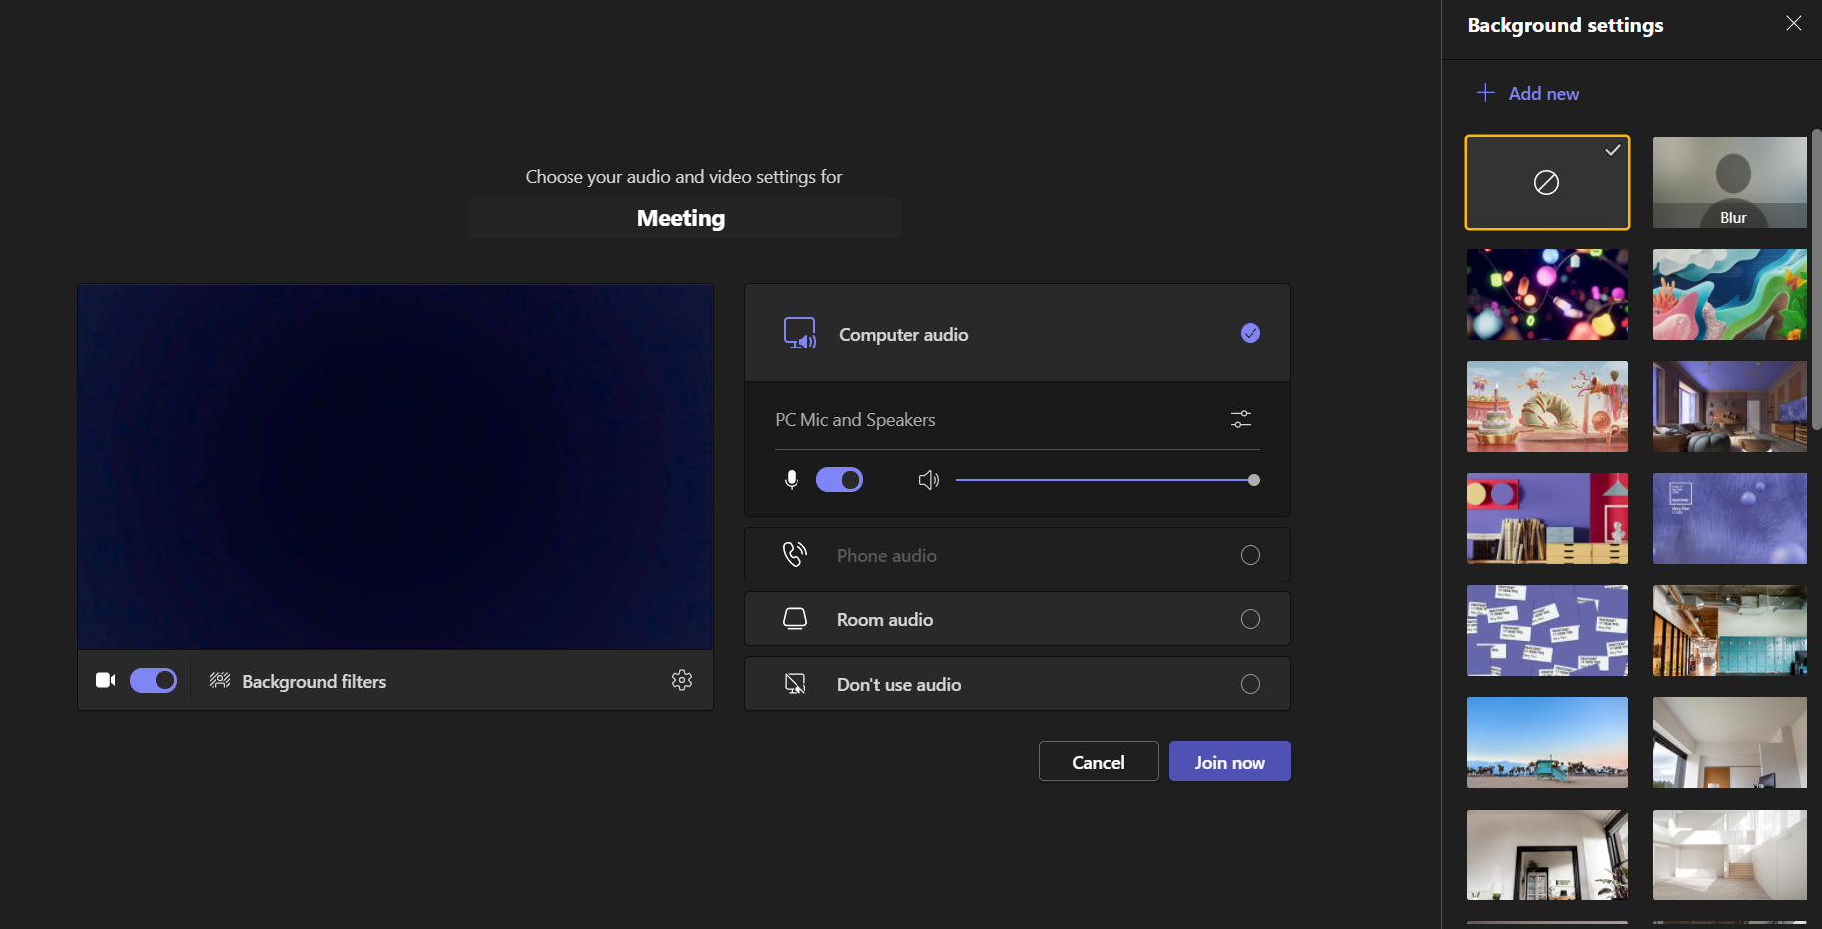
Background filters
If you do not wish to have your camera displaying your personal environment, Microsoft Teams has a solution to this problem…
Step One: Before you join a Teams video call, click the ‘Background Filters’ option.
Step Two: On the right-hand side, you can select any of the stock images.
Step Three: The image you choose will then appear in your background on the video call.
If you need any further support in regards to this requirement, please speak to your tutor directly.

Slide 5
Database
You will work on with “world” database from mysql website resources. Please refer to the link to learn more about this database.
Link: https://dev.mysql.com/doc/world-setup/en/
Please read Preface and Legal Notices.

Slide 6
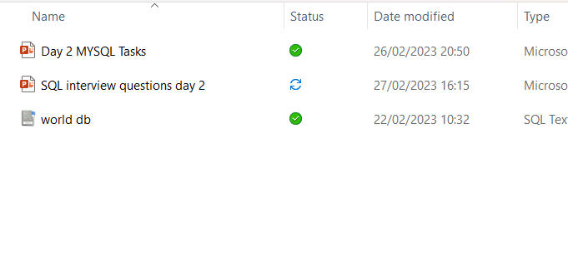
Download Database SQL Script
You can find database in Teams files.

Slide 7
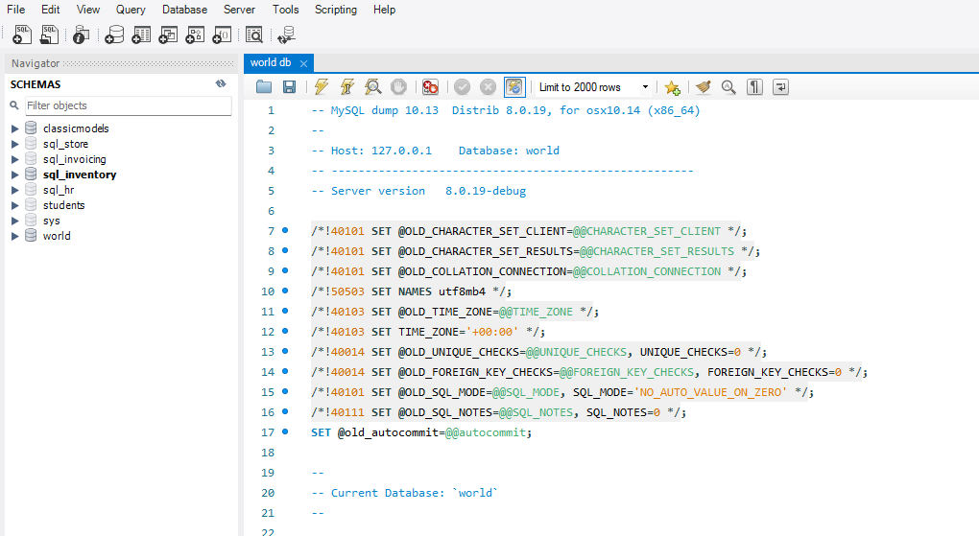

Import and Execute
Import SQL Script “world db” and then execute the script. Refresh schemas and check if db “world” exits.

Slide 8
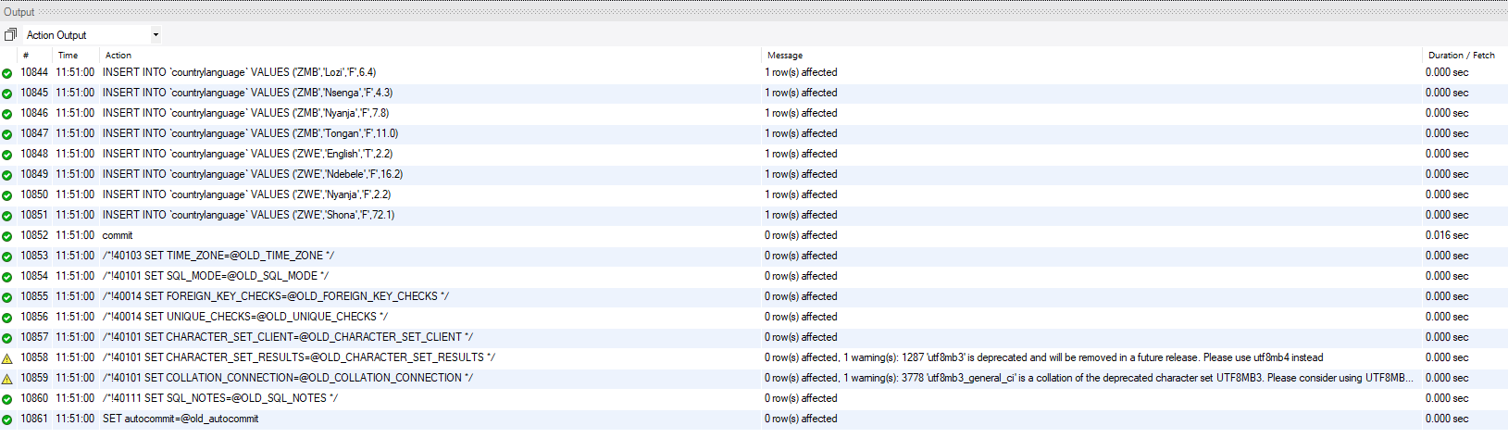
Once executed you will see the below actioned Output

Slide 9
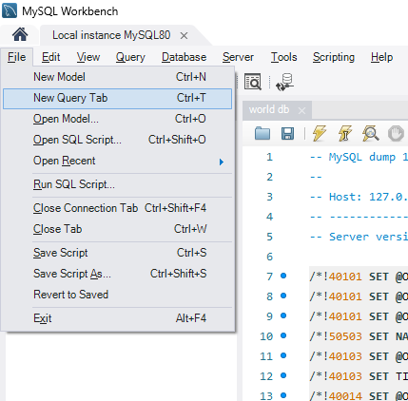
New Query Tab
On your keyboard hold down Ctrl and T keys to open new query tab.
Or you can do it from task bar

Slide 10
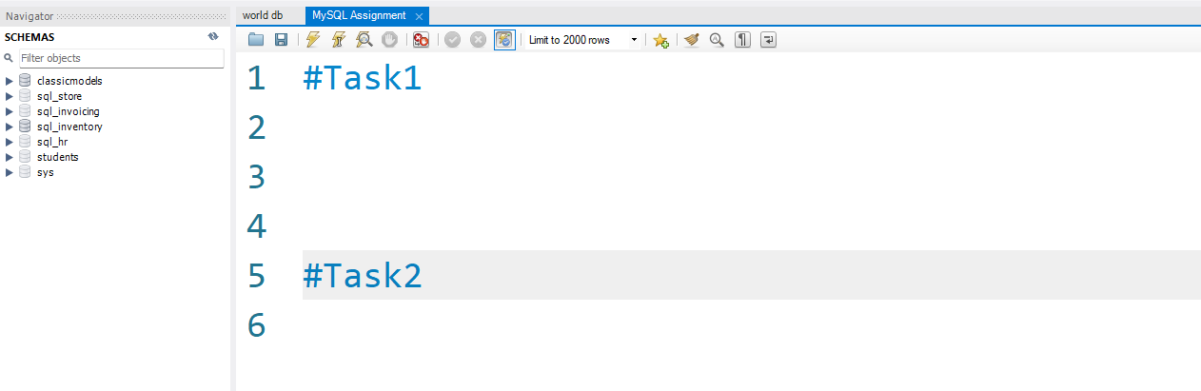
Saving Task and Queries
Use # key to comment your tasks. You will need to save this query tab for trainers review later. Please use same query tab for all your tasks.

Slide 11
Task 1
Using count, get the number of cities in the USA

Slide 12
Task 2
Find out what the population and average life expectancy for people in Argentina (ARG) is.

Slide 13
Task 3
Using ORDER BY, LIMIT, what country has the highest life expectancy?

Slide 14
Task 4
Select 25 cities around the world that start with the letter 'F' in a single SQL query.

Slide 15
Task 5
Create a SQL statement to display columns Id, Name, Population from the city table and limit results to first 10 rows only.

Slide 16
Task 6
Create a SQL statement to find only those cities from city table whose population is larger than 2000000.

Slide 17
Task 7
Create a SQL statement to find all city names from city table whose name begins with “Be” prefix.

Slide 18
Task 8
Create a SQL statement to find only those cities from city table whose population is between 500000-1000000.

Slide 19
Task 9
Create a SQL statement to find a city with the lowest population in the city table.

Slide 20
Challenge yourself (Optional)
BONUS (These tasks require knowledge of JOINs. Try yourself. Don’t worry if you don’t get it right. 😊)
Create a SQL statement to find the capital of Spain (ESP).
Create a SQL statement to list all the languages spoken in the Caribbean region.
Create a SQL statement to find all cities from the Europe continent.

Slide 21
Creating an EER Diagram

Slide 22
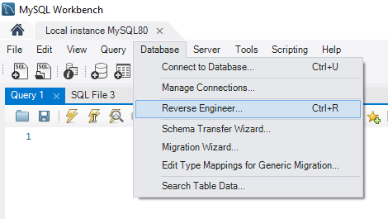

Slide 23
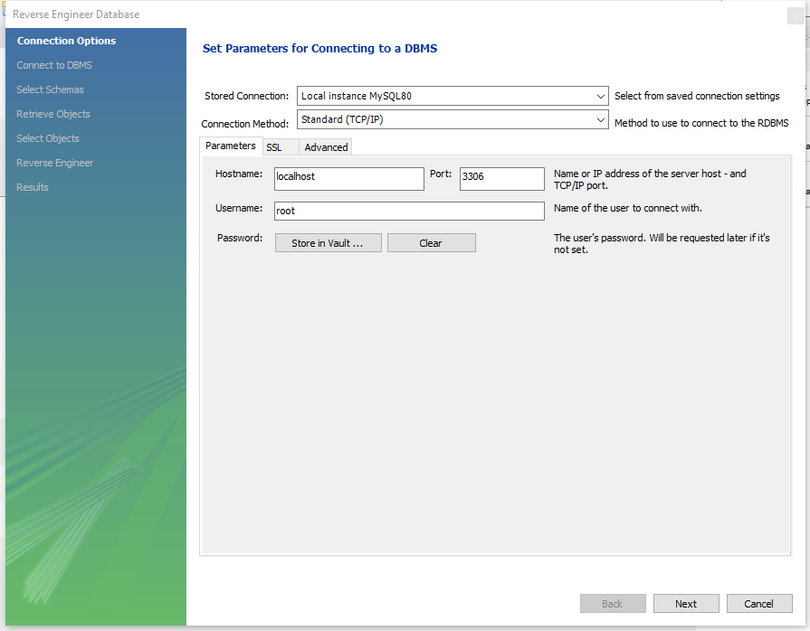

Slide 24
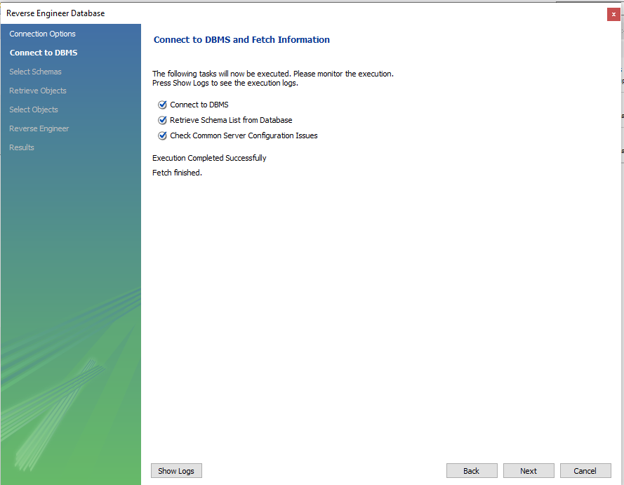

Slide 25
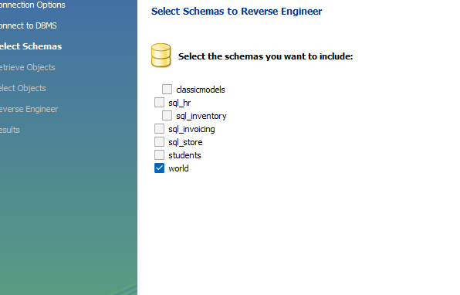
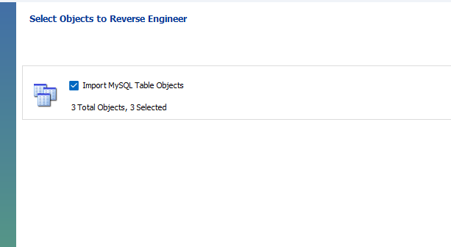

Slide 26
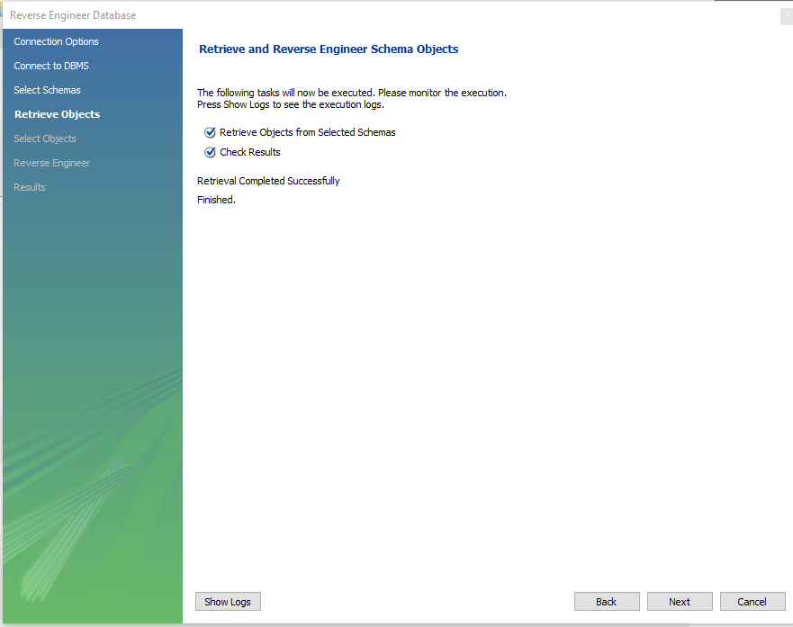

Slide 27
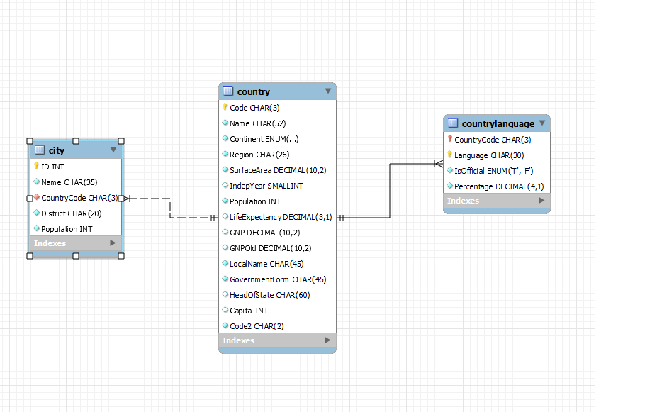

Slide 28
Task 7
Create a MS Word file name it as ''SQL_Assignment 2-YourName'' for your answers.
Identify the primary key in country table.
Identify the primary key in city table.
Identify the primary key in countrylanguage table.
Identify the foreign key in city table.
Identify the foreign key in countrylanguage table.

